Slide 1

TARA
By Goa IT Professionals
Mission:
Make it convenient for every citizen to use Public Transport, saving fuel and protecting the environment.

Slide 2
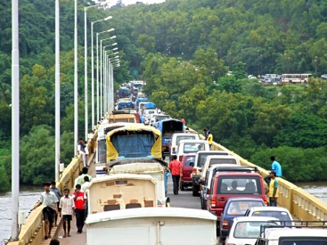
Problem
Rampant rise in personal vehicles
Major toll on the state's infrastructure, peacefulness and environment
Lack of awareness of public transport options

Slide 3
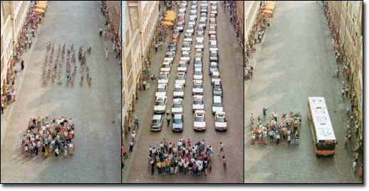
Solution
Provide public transport timetables and boarding points to citizens
Upload time-tables and boarding points to Google
Google displays public transport options on map
People will be able to plan their commute in advance
Gradual decrease in use of personal vehicles

Slide 4


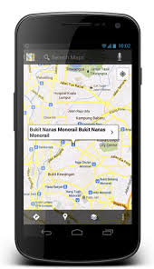
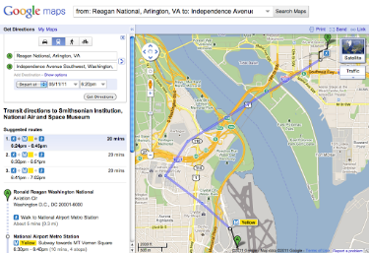
Product – The TARA Project
Transit Agency Route Administrator (TARA)
Allows the transit agency to visually define the details of their fleet such as stops, routes, trips and timings.
Allows the fleet details to be managed on a Google Map using a very intuitive User Interface that greatly simplifies the entire process of uploading the data to Google.
Is multi-tenant and hence allows employees of multiple fleets to simultaneously work on the same product.
Provide fleet settings
TARA
GTFS data
Travel options
Google Maps on mobile
Google Maps on website

Slide 5
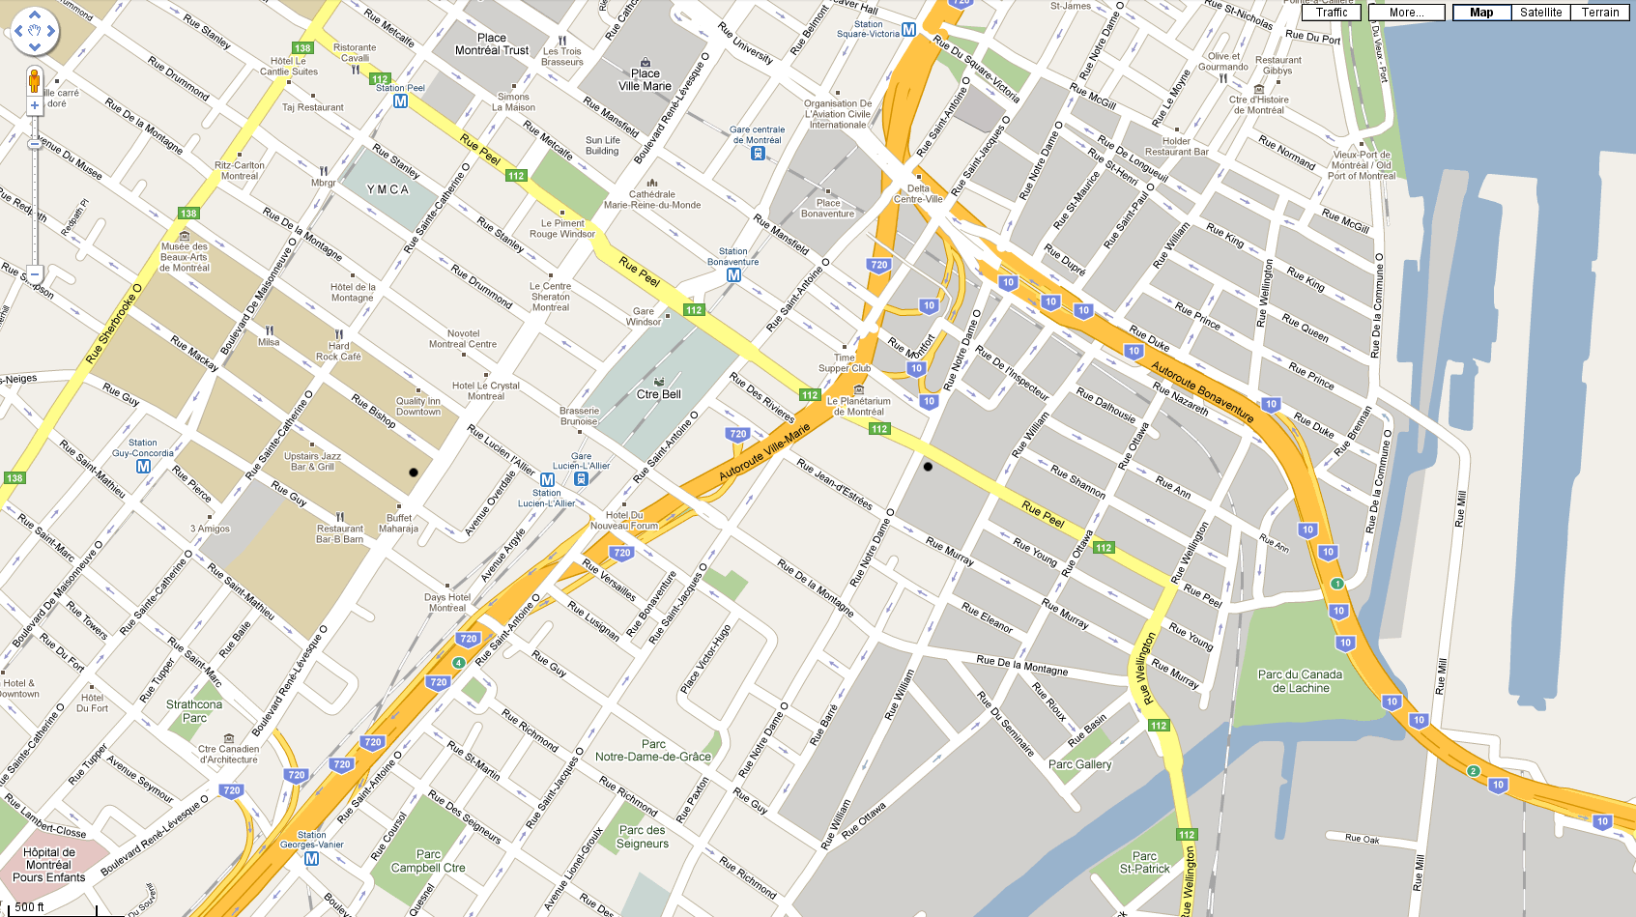

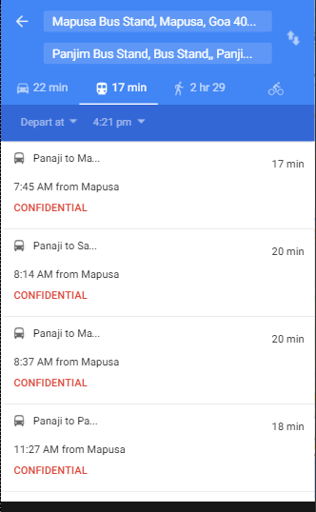
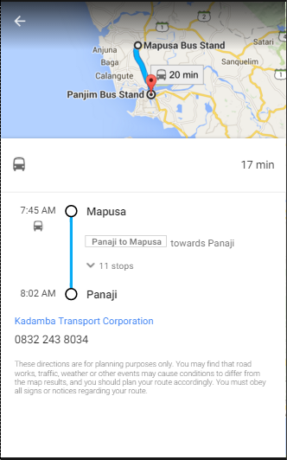
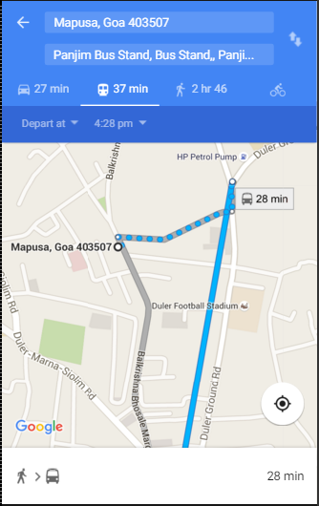
Passenger Experience on Google Maps
Timings for different trips from source to destination
Detailed display of chosen trip on a route
Step-by-step directions including different modes such as Walking, Ferries, and Buses.

Slide 6
Team
Chaitanya Bhiwa Malik (Software developer)
B.E. Computer Engg.
Agri – Entrepreneur
Yash Ganthe (Mentor)
B.E. Computer Engg.
V. P. Goa IT Professionals
Looking for sales personnel
Assigned to Transit Agencies as Relationship Managers
Preference to Goans

Slide 7
Our USP
A company in Europe offers similar service at an annual rate of 12 Lakhs.
We are not aware of any other prominent company that provides an equivalent service in India.
The TARA application provides a much more simplified user interface for data entry that the competing application.
Unique features
Auto-completion of trip timings
Support for stops across either side of roads

Slide 8
Milestones
Partnership with Kadamba and River Navigation
Got insights into operations of Transit agencies
Data entry in progress
Going Live in May 2016
Future enhancements
Further Improve the User Interface.
Once the time-table data is digitized, it can be presented to citizens through multiple additional channels such as SMS, IVR, websites, etc.
Passenger-experience can be further enhanced by providing real-time status updates of every trip provided the transit agencies install GPS devices.

Slide 9
Learnings
Data entry operators need training to perform data entry
The best source of precise data is a driver or a conductor
Data entry is done most effectively from a bus depot where drivers or conductors are present
Google performs extensive testing on uploaded data
It takes about 2 months to make the data Live on Google

Slide 10
Goals
Cover all transit agencies in Goa in year 2016-17.
Cover major transit agencies in Maharashtra and Karnataka in year 2017-18.
Provide a Pan-India service for road, rail and water based fleets in year 2018-19.
Become a key player in the country’s Digital India Mission.
Assistance needed
Support from Govt of Goa in playing the role of an enabler in on-boarding data from fleets operating in Goa.

